Slide 1
Salary Prediction
Analysis
Jeancarlo Garcia

Slide 2
Problem
to solve
Can we predict whether a person makes less or equal to $50k or more a year?

Slide 3
Brief Introduction
to Dataset
A classification type problem sourced from Kaggle.
The data takes a lot into consideration. Important data includes education, age, occupation, native-country, gender, hours worked per week and marital-status to name a few.

Slide 4
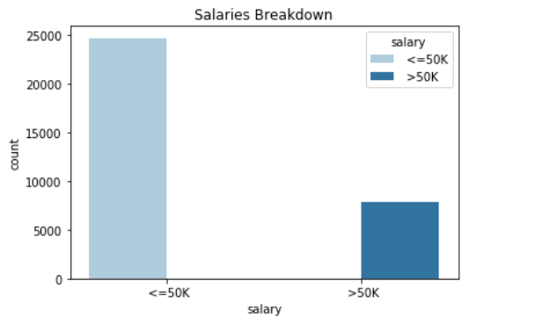
Salary
Breakdown
76% of our data consists of people who make less than or equal to $50k
7,839 individuals out of the 32,537 fall into the greater than $50k category.

Slide 5
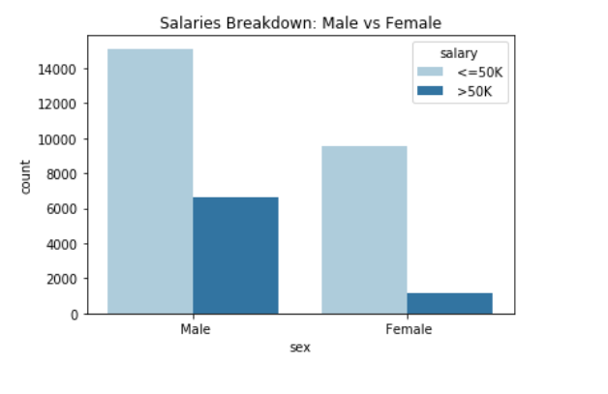
Salary Breakdown:
Male vs Female
67% of our data is made up of the Male gender
This creates an imbalance with our dataset. This may be due to the year our data was pulled from (1994 Census).

Slide 6
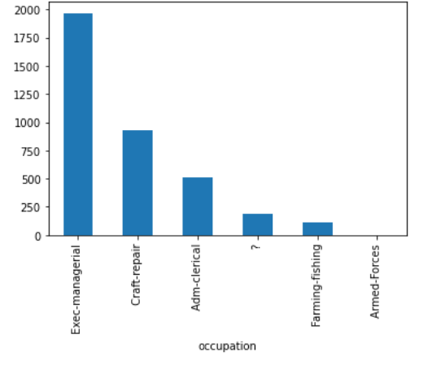
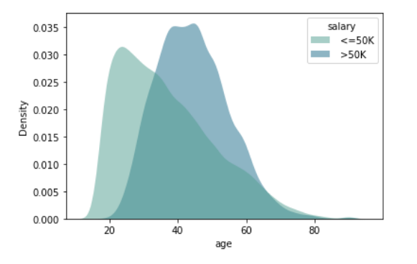
Findings
The top 3 occupations were found to be Exec-Managerial, Craft repair and Admin-Clerical positions.
Most individuals making more than $50k tend to be of an older age than those that make less than or equal to $50k.

Slide 7
Model
Limitations
Model performs pretty well in predicting whether an individual makes more than $50k or falls under the less than or equal to $50k category.
The large dataset does help with making predictions much more reliable along with the many features.
Our limitation impacting our model may be due to it being real world data based in the year 1994. The workforce being male dominated at the time does skew our data some.

Slide 8
Final Recommendations
Taking into consideration that our dataset involves real world data. The data can be missing important input due to user error.
A more up to date dataset may present a more balanced class to allow for better predictions of salary.
Understanding this, the model still provided optimal results in our prediction problem.
Use of other machine learning techniques may yield stronger results.
More experience in the right occupation will tend to allow for higher salaries.

Slide 9
References
F1 Score vs Accuracy Score
Kaggle
Classification Reports
Filter for Bar Chart
Github

